Slide 1
CS630 AI Agent Engineering Module 03 Experiencing LiteLLM and OpenRouter
Unified Proxy
Proxy Server
LiteLLM
System Design Components of LiteLLM
OpenRouter
LiteLLM vs OpenRouter
Class Diagram and Deployment Diagram

Slide 2
Unified Proxy
A unified proxy is a single access point that lets you talk to multiple backends (in this case, LLM providers) using one consistent interface.
In plain terms:
Instead of learning 5 different APIs for 5 different models (like OpenAI, Anthropic, Groq…), you send all your requests to LiteLLM, and it handles the rest.
"One API, many LLMs behind the scenes."

Slide 3
Proxy
A proxy acts like a middleman:
You send a request to the proxy.
The proxy talks to the actual server.
The proxy sends the server’s response back to you.In software (like LiteLLM):
In software (like LiteLLM):
The client (your app) sends a request to LiteLLM.
LiteLLM (the proxy) forwards that request to the right LLM provider (like OpenAI or Anthropic).
It then returns the response to your app — all while handling auth, rate limits, and logging.
Notes:
Metaphor: It’s like ordering food from multiple restaurants through a single delivery app — the app (proxy) deals with each restaurant so you don’t have to.

Slide 4
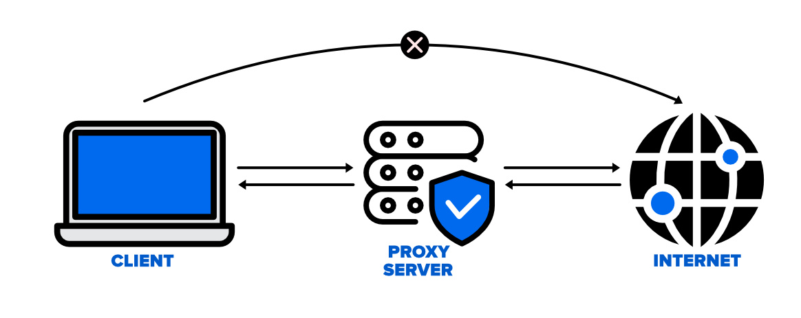
Proxy
Notes:
The most common use case for a proxy server is:
To act as an intermediary between users and the internet, providing access control, security, and anonymity.
In everyday terms: "Filtering and forwarding web traffic between users and websites."

Slide 5
Why Use a Proxy Server?
Abstraction & Simplification
Flexibility & Swapability
Centralized Control
Logging & Observability
Security
Caching (Performance)
Load Balancing & Resilience
Notes:
1. Abstraction & Simplification
You interact with one consistent interface, even if multiple systems or APIs are involved behind the scenes.
E.g., with LiteLLM, you use the OpenAI API format for any LLM provider.
2. Flexibility & Swapability
Easily switch or route between backends without changing your app.
If OpenAI is down, route to Claude or Groq with fallback logic.
3. Centralized Control
Apply rate limiting, authentication, and monitoring in one place.
Enforce organization-wide policies (e.g., usage limits, model access control).
4. Logging & Observability
Collect request logs, metrics, and usage data for debugging, billing, or optimization.
Hook into tools like Prometheus, Lunary, or LangFuse.
5. Security
Hide or protect backend services from direct exposure.
Prevent misuse or abuse by validating API keys and enforcing usage rules.
6. Caching (Performance)
A proxy can cache frequent responses to improve speed and reduce backend load.
7. Load Balancing & Resilience
Distribute traffic across multiple providers or instances.
Retry or fall back if one provider fails.

Slide 6
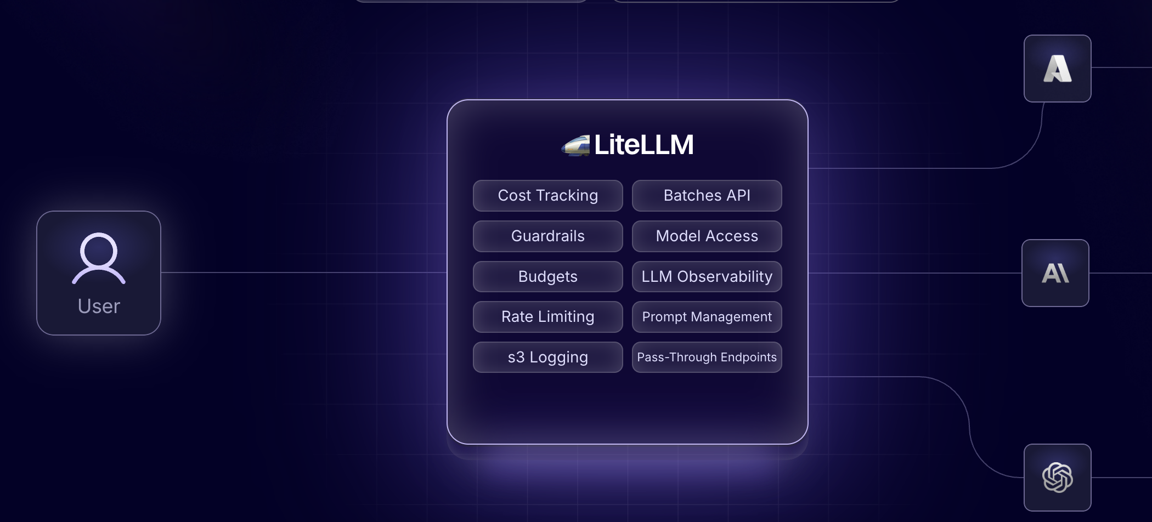
LiteLLM
(LiteLLM, 2025a)
Notes:
🔧 What is LiteLLM?
LiteLLM is an open-source proxy and unification layer for calling multiple Large Language Models (LLMs) (like OpenAI, Anthropic, Azure, Mistral, Groq, Ollama, etc.) via a standard OpenAI-compatible API interface.
It’s designed to:
Make switching between LLM providers easy.
Offer observability, rate limiting, caching, and logging.
Support local and cloud-hosted models alike.
🎯 Why Was LiteLLM Created?
As more LLM providers and model variants emerged, developers faced increasing complexity in integrating and managing them. LiteLLM was created to simplify, unify, and operationalize this growing mess.
🧩 Problem 1: Too Many APIs
Each LLM provider (OpenAI, Anthropic, Azure, Cohere, Mistral, etc.) has:
Its own API syntax
Different authentication mechanisms
Different response formats
➡️ This breaks portability. You’d have to rewrite your code every time you switch models or providers.
⚙️ Problem 2: Hard to Switch or Compare Models
Want to A/B test GPT-4 vs Claude 3?
Or fall back from OpenAI to Groq if latency is high?
➡️ Normally, this would require a lot of custom logic and vendor-specific code. There was no unified interface.
💵 Problem 3: No Built-in Cost/Usage Control
Teams needed to:
Monitor token usage
Set budget limits
Know which provider was used and how much it cost
➡️ Most providers don’t offer this natively, and you’d have to build dashboards manually.
🔍 Problem 4: No Observability Across Models
Once in production, teams needed:
Logs
Metrics
Streaming support
Failure tracing across providers
➡️ This is hard to do consistently when working with multiple LLMs.
✅ LiteLLM Was Created To:
1. Unify LLM APIs
Expose one OpenAI-compatible API
Map model names to many providers
Write code once and plug in any LLM
2. Add Operational Superpowers
Rate limiting
Caching
Observability
Prompt templating
3. Enable Hybrid LLM Infrastructure
Mix and match local and hosted models
Run lightweight inference or routing logic locally
Deploy as a single proxy server or microservice
4. Empower Teams to Move Fast
Rapid prototyping
Easy model experimentation
No vendor lock-in
✨ Origin and Community
LiteLLM was started by engineers from the Better Engineering community (same group that made tools like OpenDevin and Chainlit) who saw the need for:
A fast, lightweight proxy
Built for LLM Ops
Easy enough for individuals, powerful enough for teams

Slide 7
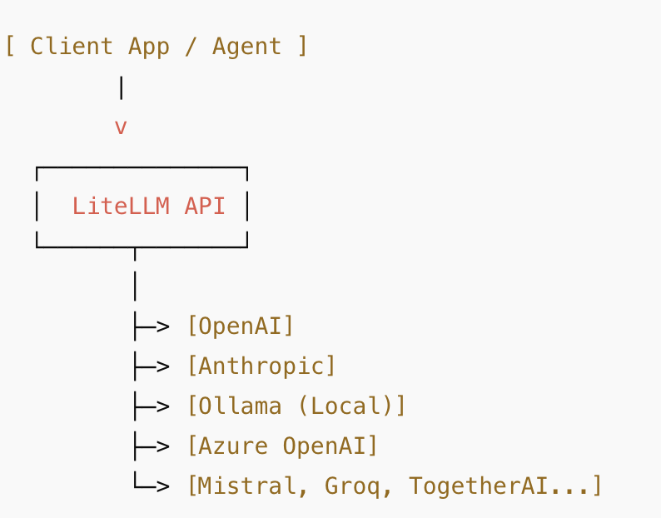
LiteLLM Architecture Overview
(LiteLLM, 2025a)
Notes:
🏗️ LiteLLM Architecture Overview
Here’s how you can explain it in layers or components:
1. Client Layer
Applications (like your frontend, server, or agents) make requests to LiteLLM using the OpenAI API format (e.g., chat/completions, embeddings, etc.)
This means developers don’t need to change their client-side code when switching providers.
2. Proxy Layer (LiteLLM Core API)
This is the heart of LiteLLM:
OpenAI-compatible endpoints receive requests.
Parses model name and routes the request to the correct provider adapter.
Example: If the request specifies "model": "gpt-4", it might call OpenAI; if it says "model": "claude-2", it calls Anthropic.
3. Provider Abstraction Layer
A plug-and-play system that maps each model name to a specific provider backend (OpenAI, Azure, Groq, TogetherAI, etc.).
Each provider has a handler/adapter that:
Translates requests into provider-specific formats.
Handles API keys and authentication.
Converts provider responses back into the OpenAI response format.
4. Middleware (Optional but Powerful)
LiteLLM supports middlewares for:
Observability (logs, metrics) – Prometheus, OpenTelemetry.
Caching – avoid redundant API calls.
Rate limiting / Cost control – restrict token usage or frequency.
Custom routing – load balancing, A/B testing, fallback strategies.
5. Admin / Monitoring Layer
Dashboards or logs (e.g., via Weights & Biases or Grafana) to:
Track usage
Visualize request patterns
Set alerts on failures or overuse

Slide 8
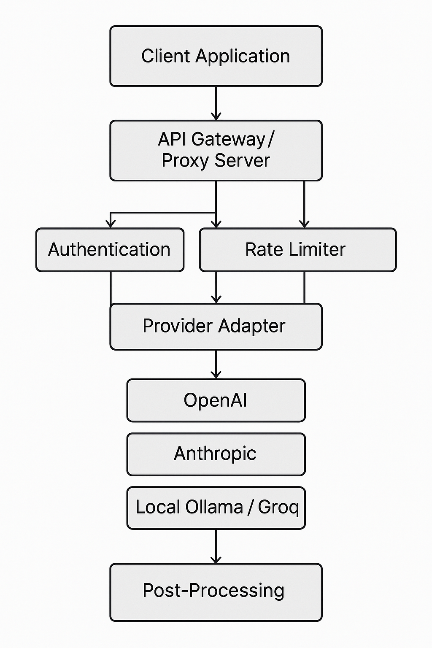
System Design Components of LiteLLM
Notes:
🧱 Basic System Design Components of LiteLLM
1. Client / User Application
Could be a chatbot, web app, or API caller.
Sends HTTP requests (e.g., /chat/completions) using OpenAI-compatible format.
2. API Gateway / Proxy Server
The LiteLLM Proxy Server (often proxy_server.py) exposes OpenAI-style endpoints.
Main responsibilities:
Authenticate requests (via Virtual Keys)
Rate-limit and budget-check
Route requests to appropriate LLMs
3. Authentication & Authorization
Uses Bearer tokens called Virtual Keys.
Validated through:
In-memory cache
Redis cache
Database fallback
Associates usage to users/teams and applies budget limits.
4. Rate Limiter / Usage Controller
Manages token-per-minute (TPM), requests-per-minute (RPM) for:
Global server
Individual keys
Users
Teams
Enforced using a MaxParallelRequestsHandler or similar internal middleware.
5. LiteLLM Router
Core logic that:
Chooses which model/provider to use
Handles load balancing, fallbacks, and retries
Supports local and cloud models
6. Provider Adapters
Each LLM provider (OpenAI, Anthropic, Mistral, Groq, etc.) has an adapter.
Translates the generic API request into the provider’s format.
Receives response and translates it back to OpenAI-compatible format.
7. Post-Processing Layer
Runs asynchronous tasks after responding to user:
Logs request/response to tools like:
Lunary
LangFuse
MLflow
Updates usage in the LiteLLM database
Updates rate limiter counters
8. Database
Stores:
Virtual key metadata
Usage stats (tokens used, cost, etc.)
User/team associations
May be PostgreSQL or another relational DB.
9. Observability Stack (Optional)
Can plug into:
Prometheus / Grafana for metrics
OpenTelemetry for tracing
Logging systems for audit/debug
10. Deployment Components
Typically deployed as a Docker container, often behind:
A reverse proxy (e.g., NGINX)
Can scale horizontally using Kubernetes or similar

Slide 9
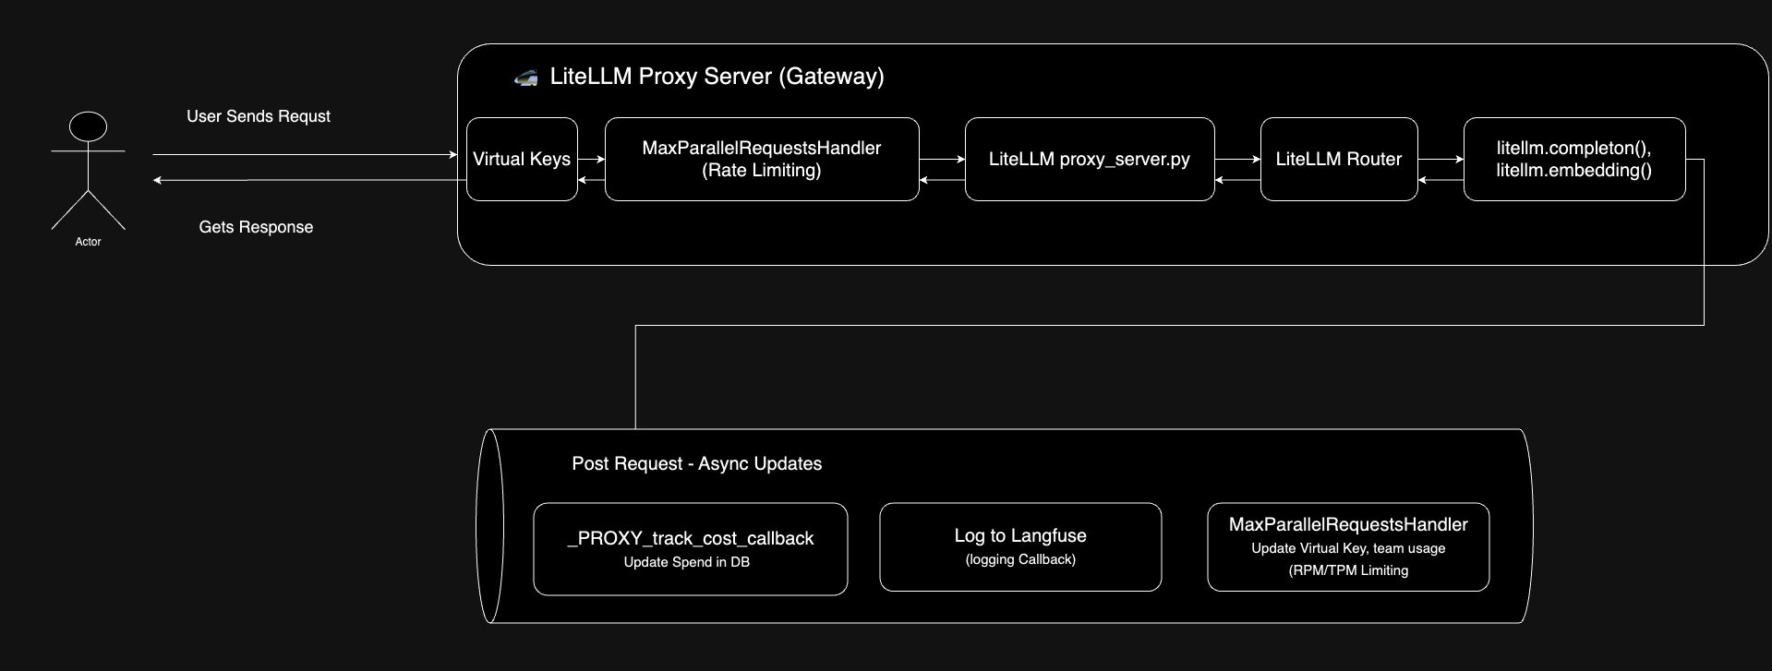
LiteLLM's Life of a Request
(LiteLLM, 2025b)
Notes:
LiteLLM Request Flow – Explained Simply
User Sends a Request A user sends a request to the LiteLLM Proxy Server — this is the entry point.
Virtual Key Validation LiteLLM checks the bearer token (called a virtual key) to make sure it’s:
Valid
Within its usage budget
It first looks in the cache (Redis or memory), and if not found, checks the database.
Rate Limiting Checks Next, it makes sure limits aren't exceeded — checking:
Global server limits
Per-key limits
Per-user and team limits
Request Handling by proxy_server.py Requests to /chat/completions or /embeddings are passed to the LiteLLM Router.
LiteLLM Router The router manages:
Load balancing
Fallbacks if a model fails
Retries to ensure reliability
Calling the Right LLM The litellm SDK sends the request to the correct LLM provider using the OpenAI-style format, translating as needed.
Post-Request Processing (Happens in Background) After the response is returned:
Usage is logged (e.g., to Lunary or MLflow)
Rate counters are updated
Spend and usage are saved to the database for tracking
Request Flow
User Sends Request: The process begins when a user sends a request to the LiteLLM Proxy Server (Gateway).
Virtual Keys: At this stage the Bearer token in the request is checked to ensure it is valid and under it's budget. Here is the list of checks that run for each request
2.1 Check if the Virtual Key exists in Redis Cache or In Memory Cache
2.2 If not in Cache, Lookup Virtual Key in DB
Rate Limiting: The MaxParallelRequestsHandler checks the rate limit (rpm/tpm) for the the following components:
Global Server Rate Limit
Virtual Key Rate Limit
User Rate Limit
Team Limit
LiteLLM proxy_server.py: Contains the /chat/completions and /embeddings endpoints. Requests to these endpoints are sent through the LiteLLM Router
LiteLLM Router: The LiteLLM Router handles Load balancing, Fallbacks, Retries for LLM API deployments.
litellm.completion() / litellm.embedding(): The litellm Python SDK is used to call the LLM in the OpenAI API format (Translation and parameter mapping)
Post-Request Processing: After the response is sent back to the client, the following asynchronous tasks are performed:
Logging to Lunary, MLflow, LangFuse or other logging destinations
The MaxParallelRequestsHandler updates the rpm/tpm usage for the
Global Server Rate Limit
Virtual Key Rate Limit
User Rate Limit
Team Limit
The _ProxyDBLogger updates spend / usage in the LiteLLM database. Here is everything tracked in the DB per request

Slide 10
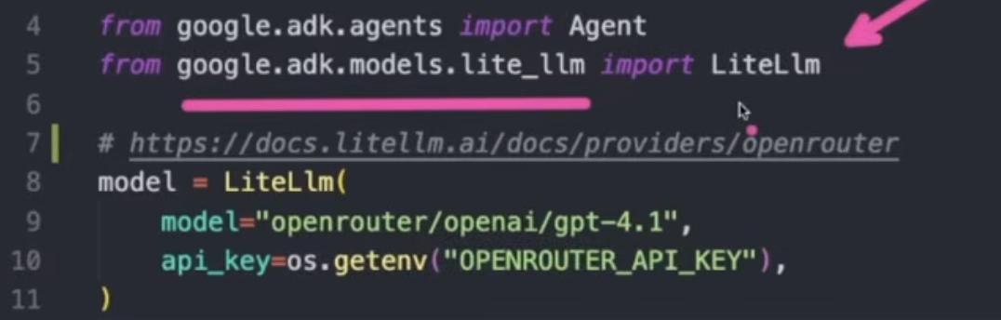
OpenRouter
OpenRouter is a hosted API gateway that lets you access multiple LLMs (like GPT-4, Claude, Mistral, etc.) through a single OpenAI-compatible API, without needing your own API keys for each provider.

Slide 11
LiteLLM vs OpenRouter: What's the Difference?
LiteLLM – Build Your Own Proxy (Self-hosted)
What it is: A self-hosted proxy server and Python SDK that lets you route OpenAI-style requests to multiple providers (OpenAI, Anthropic, Groq, Ollama, etc.)
Use case: Ideal for developers and teams who want full control over routing, observability, rate limits, fallback logic, and logging.
Supports: Local models, custom middlewares, API monitoring, prompt templating.
Installable: Yes – you run it on your own infra (Docker, EC2, local, etc.)

Slide 12
LiteLLM vs OpenRouter: What's the Difference?
OpenRouter – Public Hosted API Gateway
What it is: A hosted API gateway that lets you call many LLMs (OpenAI, Claude, Mistral, Gemini, etc.) using a single OpenAI-style endpoint.
Use case: Ideal for developers who want quick access to multiple models without worrying about accounts or billing setup per provider.
Supports: Pay-as-you-go usage, usage dashboards, hosted token management.
Installable: ❌ No – it’s a public service, not self-hosted.

Slide 13
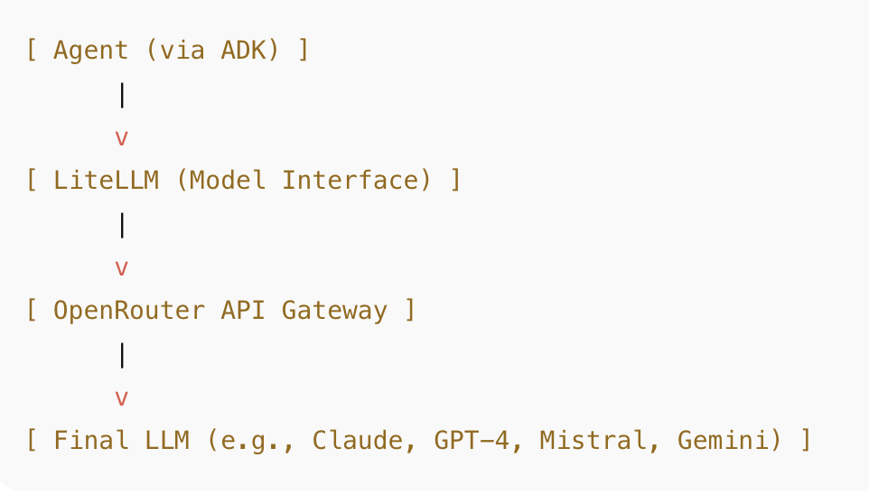
LiteLLM and OpenRouter
The LlmAgent acts as the "thinking" part of your application.
LlmAgent behavior is non-deterministic.
interpret instructions and context, deciding how to proceed, which tools to use or transfer to another agent.
Effective LlmAgent involves defining its identity, clearly guiding its behavior through instructions, and equipping it with the necessary tools and capabilities.
(Google, 2025)
Notes:
Summary:
LiteLLM = Your local client-side interface for calling LLMs in OpenAI format.
OpenRouter = Your hosted unified proxy, managing all backend LLMs.
You're not self-hosting the proxy server (LiteLLM can do that, but you're using OpenRouter instead)

Slide 14
ADK, LiteLLM and OpenRouter
ADK uses LiteLLM as the model abstraction layer.
You configure LiteLLM to send requests to OpenRouter (just like you would with OpenAI).
OpenRouter then forwards those requests to the final LLM provider (e.g., Mistral, Claude, etc.).
The response flows back up the chain to your agent.

Slide 15
Why Use This Setup?
LiteLLM still acts as the proxy interface — it gives you a consistent way to call any model.
OpenRouter becomes just another backend provider LiteLLM can talk to.
This means you can:
Swap providers easily (just change the model name or API base)
Keep your code OpenAI-compatible
Still enjoy fallbacks, logging, limits via LiteLLM if self-hosted
Notes:
LiteLLM is the model wrapper, and OpenRouter is one of the engines it can drive.
You can also point LiteLLM directly to OpenAI, Anthropic, Ollama, or any provider — OpenRouter is just one route.

Slide 16
Is LiteLLM not unified proxy if used with OpenRouter?
Usage Mode | What You're Doing in ADK | Full Self-Hosted Proxy Mode
LiteLLM as Python SDK | ✅ Used in code as a model wrapper that routes to OpenRouter | ✅ Included, but also adds observability, rate limits, etc.
LiteLLM as Unified Proxy Server | ❌ Not self-hosting it, just using it to simplify API access | ✅ Yes, with self-hosted server, logging, fallbacks, etc.
Notes:
LiteLLM is the model wrapper, and OpenRouter is one of the engines it can drive.
You can also point LiteLLM directly to OpenAI, Anthropic, Ollama, or any provider — OpenRouter is just one route.

Slide 17
So what's the difference?
You ARE using LiteLLM as a proxy because it:
Translates OpenAI-style calls to OpenRouter
Lets you swap models easily (Claude, GPT-4, etc.)
You are NOT using the full unified proxy server mode because:
You're not self-hosting the LiteLLM proxy server (proxy_server.py)
You’re relying on OpenRouter’s infra, not managing model routing, caching, or rate limiting yourself
Notes:
You're using LiteLLM as a lightweight client-side proxy. The full unified proxy server adds advanced LLMOps features like rate limiting, usage tracking, and model fallback — which you're skipping (and letting OpenRouter handle).

Slide 18
OpenRouter is the Unified Proxy
OpenRouter:
Exposes a single OpenAI-compatible API
Lets you access many different models (Claude, Mistral, GPT-4, Gemini, etc.)
Handles routing, authentication, billing, and model switching for you
Acts as the middleman between your request and the actual LLM provider
So OpenRouter is effectively your unified proxy layer, even though it's a hosted service, not something you're self-hosting.

Slide 19
Can we used LiteLLM with OpenRouter?
You'd self-host the LiteLLM proxy server and configure it to route requests directly to LLM providers like:
OpenAI
Azure OpenAI
Anthropic (Claude)
Mistral
Ollama (local)
Groq
Gemini (soon or via adapter)

Slide 20
Benefits of using LiteLLM directly
Full control over routing, usage, limits, and logging
No vendor lock-in to OpenRouter
Can run locally or on your own cloud (Docker, EC2, etc.)
Supports both cloud and local models
Custom logic (fallbacks, model aliases, rate limits, etc.)
Better for enterprise or private deployments

Slide 21
Cons without OpenRouter
Concern | Details
🧾 You need your own API keys | You'll need accounts and billing set up with every LLM provider you use (e.g., OpenAI, Anthropic, etc.).
⚙️ You must deploy and manage it | You need to host LiteLLM (e.g., using Docker, on EC2, etc.), including availability and scaling.
📈 No built-in unified billing | Unlike OpenRouter, which charges you for multiple providers through one bill, you'd pay each provider separately.
🔐 Need to manage keys and secrets | You’re responsible for storing and rotating API keys securely.
🧰 Requires some setup and DevOps knowledge | Not plug-and-play like OpenRouter — you configure your own routing, model mapping, and limits.
Notes:
Yes, you can drop OpenRouter and run only LiteLLM. You'll gain control, flexibility, and transparency, but take on more setup and key management responsibility.

Slide 22
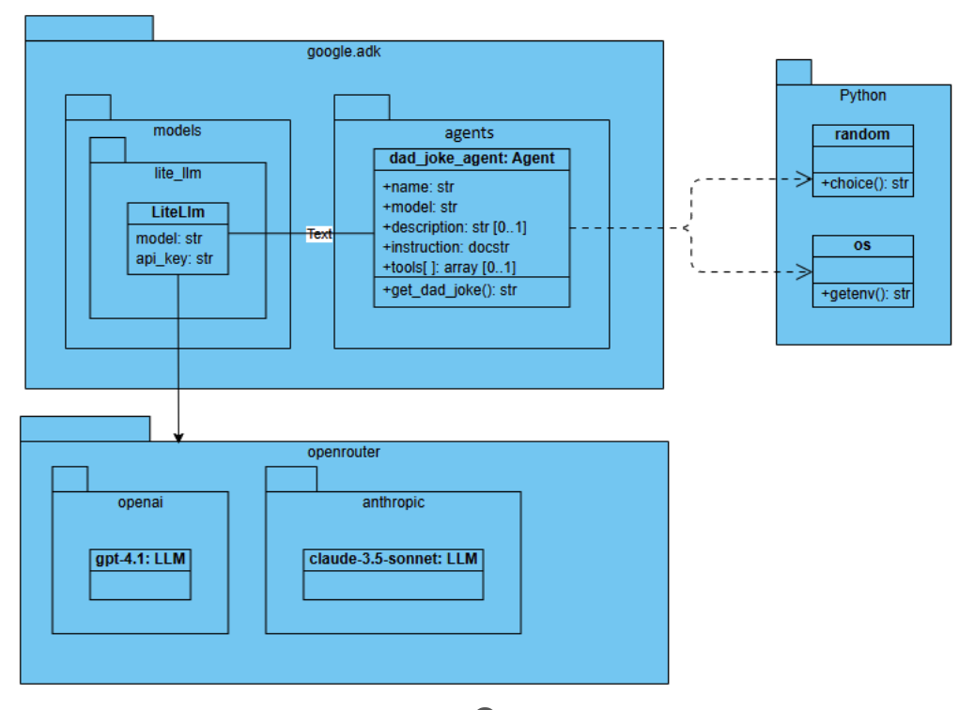
dad_joke_agent with LiteLLM class diargram

Slide 23
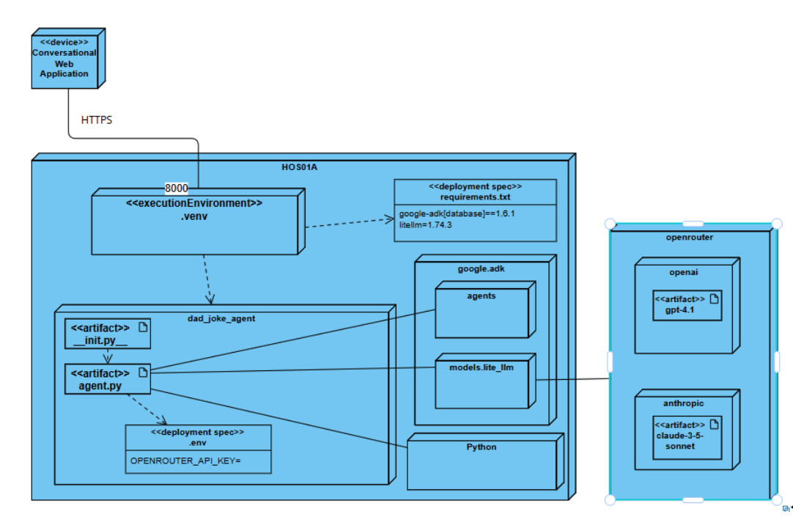
dad_joke_agent with LiteLLM deployment diagram

Slide 24
References
Google Agent Development Kit (ADK)
google-adk·PyPI
Gemini models | Gemini API | Google AI for Developers
Brandon Hancock's ADK Crash Course
Module 3: LiteLLM Agent
Brandon Hancock's ADK Masterclass: Build AI Agents & Automate Workflows (Beginner to Pro) (3:12:47)
Module 3: LiteLLM (0:35:20 – 0:43:47)
LiteLLM. (2025a). LiteLLM. Litellm.ai. https://www.litellm.ai/
‌LiteLLM. (2025b). Life of a Request | liteLLM. Litellm.ai. https://docs.litellm.ai/docs/proxy/architecture
Google. (2025). Agent Development Kit. Github.io. https://google.github.io/adk-docs/agents/llm-agents/#guiding-the-agent-instructions-instruction
‌

Slide 25

Q&A

